Slide 1
MEALS ON WINGS DRONE DELIVERY SYSTEM
Group - 5
Venuka (103763801), Geetanjali (102635116), Vishwanath (104746191), Balagopalapracheethaa (104499725), Varun (104494801)

Slide 2
Table of contents
01
02
03
04
05
Meals on Wings Overview
App Workflow
App Features and Details
Prototype Assumptions and Limitations
Live Demo

Slide 3
01
Context and Overview

Slide 4
Context and Overview
The “Meals on Wings” project is a software simulation that aims to create the best flight route for drones to transport food from restaurants to the location of customers.
We have included the features:’
Efficient Flight Paths based on GPS coordinates, flight restrictions, drone battery life and food weight etc.
Implemented Collision avoidance algorithms to the system so that the drone can avoid tall buildings and obstacles
Interfaces for Customers to order food and for admins to monitor the orders and track the orders.
Flagging invalid flight paths if the drone’s range is inadequate
Visualisation of flight routes shown in map.

Slide 5
02
Application Workflow

Slide 6
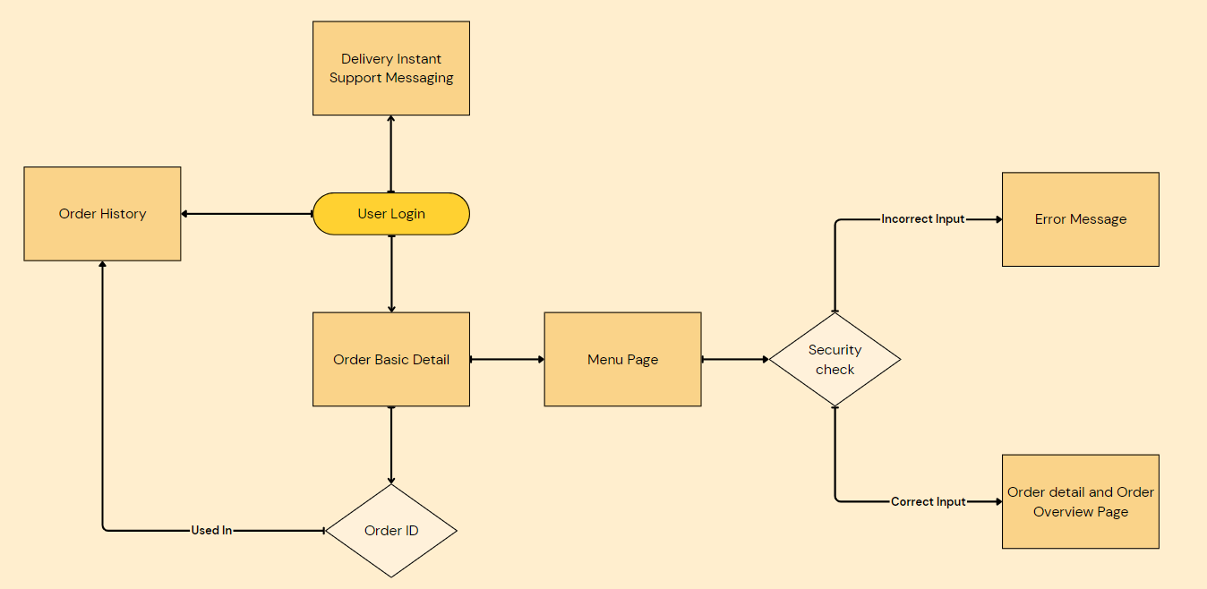
USER WORKFLOW

Slide 7
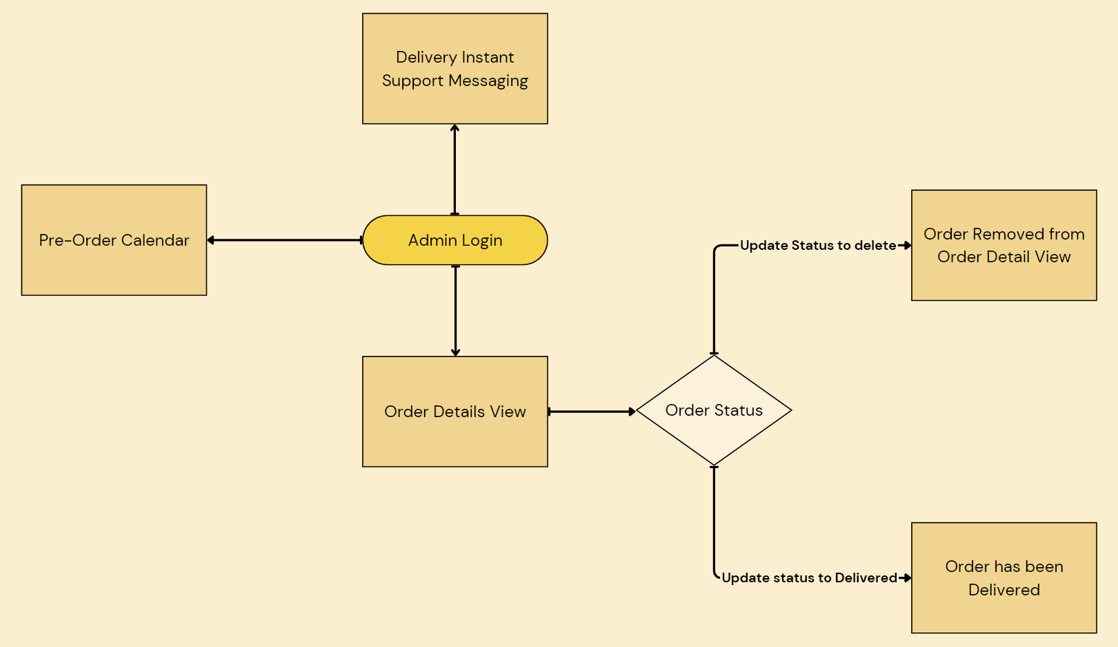
ADMIN WORKFLOW

Slide 8
03
App Features and Details

Slide 9
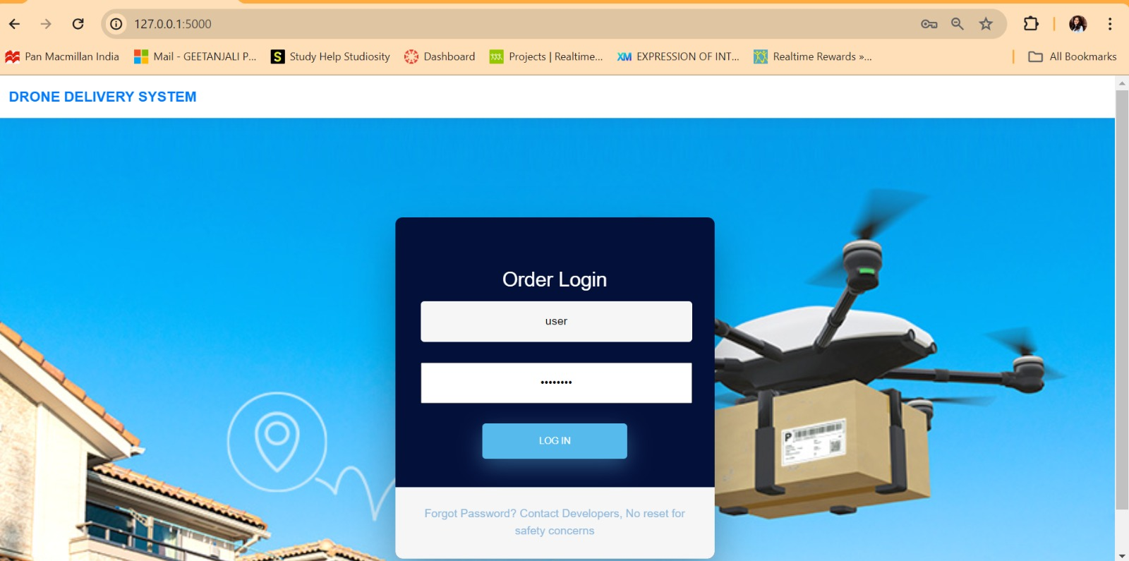
User Login
Description
The login page for Meals on Wings provides secure access for customers. It features standard username and password fields, ensuring user authentication through encrypted password storage and backend verification. The login is designed to differentiate user roles, granting appropriate access based on credentials

Slide 10
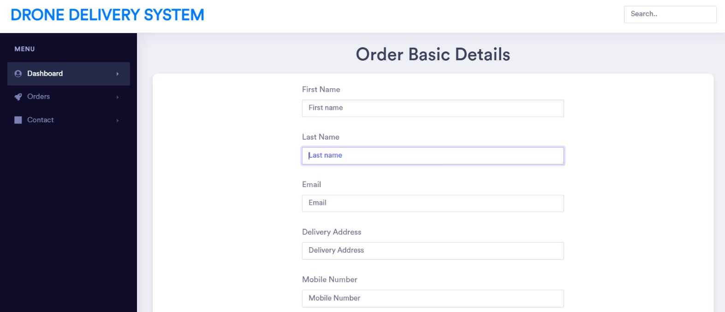
Customer Basic Details
Description
After logging in, users are prompted to provide basic details such as their name, email, address, and mobile number. This information is essential for personalizing the user experience and ensuring accurate delivery details for meal orders. The interface is user-friendly, guiding users through each input field with clear labels and validation to ensure the accuracy and completeness of the information

Slide 11
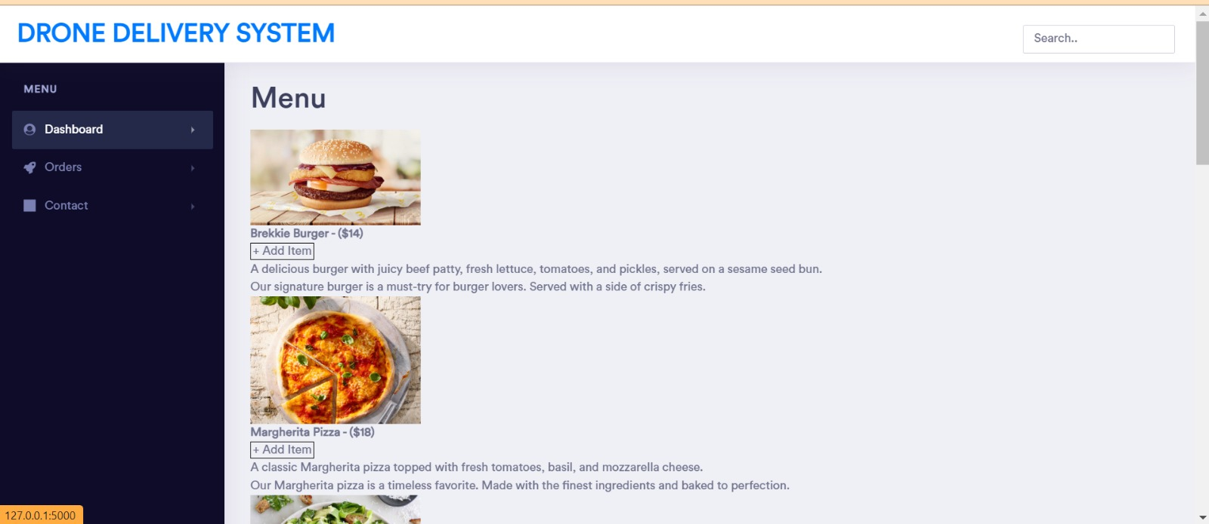
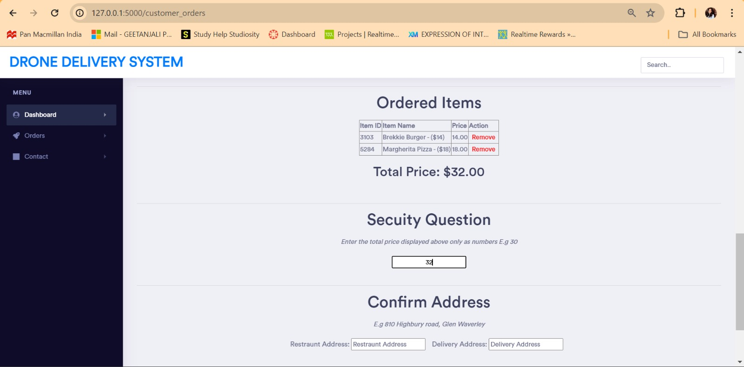
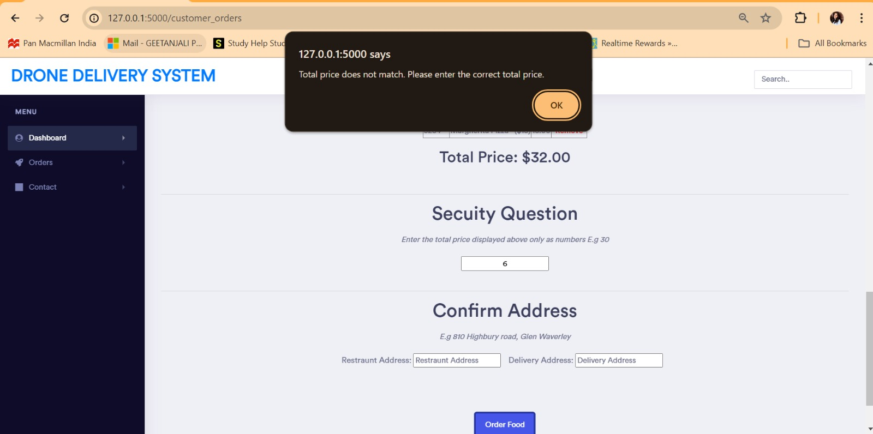
Ordering Through the Website
Description
After entering their basic details, users navigate to the menu page where they can browse and select items for ordering. Once items are selected, the page displays a summary of the selected items, including the total price. To enhance security, the page prompts the user to answer a security question. Additionally, there is a tab for confirming or updating the delivery address, ensuring that the order is sent to the correct location. This streamlined process ensures accuracy and security while providing a seamless ordering experience.

Slide 12
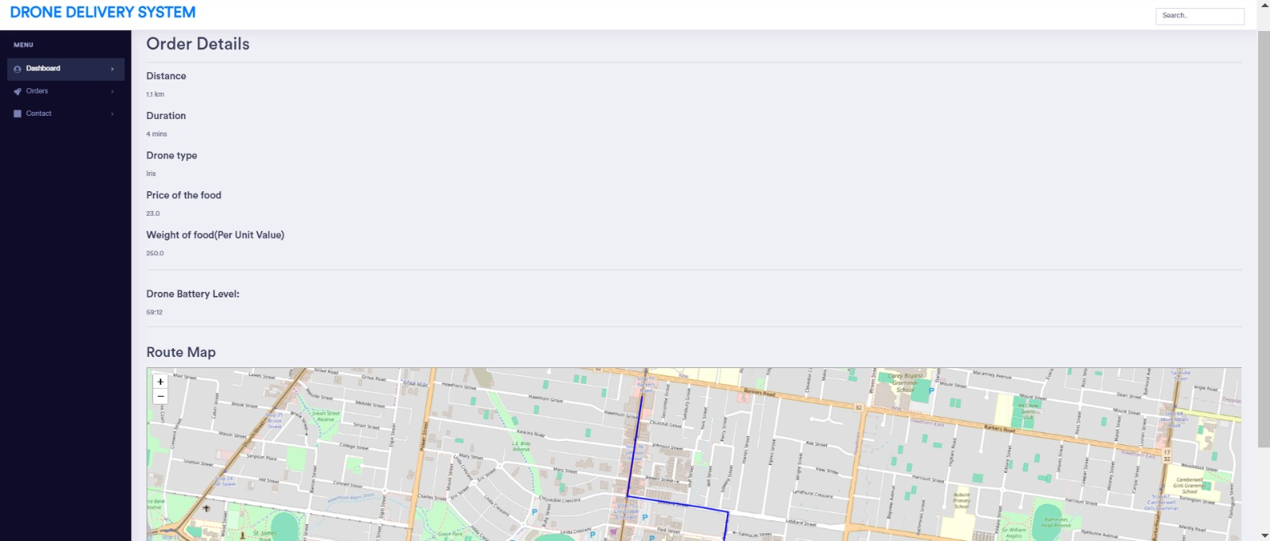
Order Tracking
Description
After confirming the order, the user is navigated to an order details page. This page provides comprehensive information about the delivery, including the distance and estimated duration of the delivery, the type of drone being used, and the price and weight of the food. Additionally, the page displays the drone's current battery level and a visual representation of the route the drone will take for delivery. This detailed overview ensures transparency and keeps the user informed about every aspect of their order and its delivery status.

Slide 13
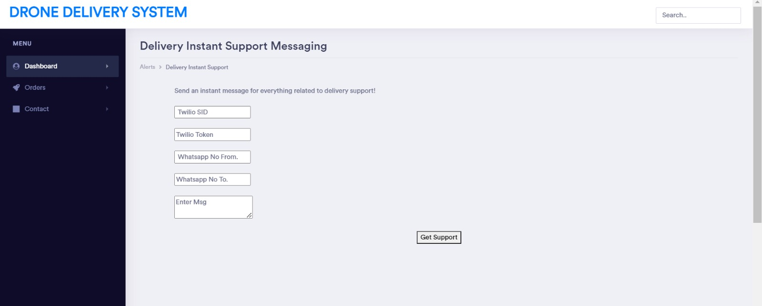
Twilio Integration
Description
We have integrated the twilio API which allows the customers to connect to the admin’s whats app under a private number. By doing so allows customer to make queries regarding their order more streamlined to the specific restaraunt. Vice versa this is also done on the admin’s side too as if any immediate issue or updates occur the admin can directly inform the customer of these queries.

Slide 14
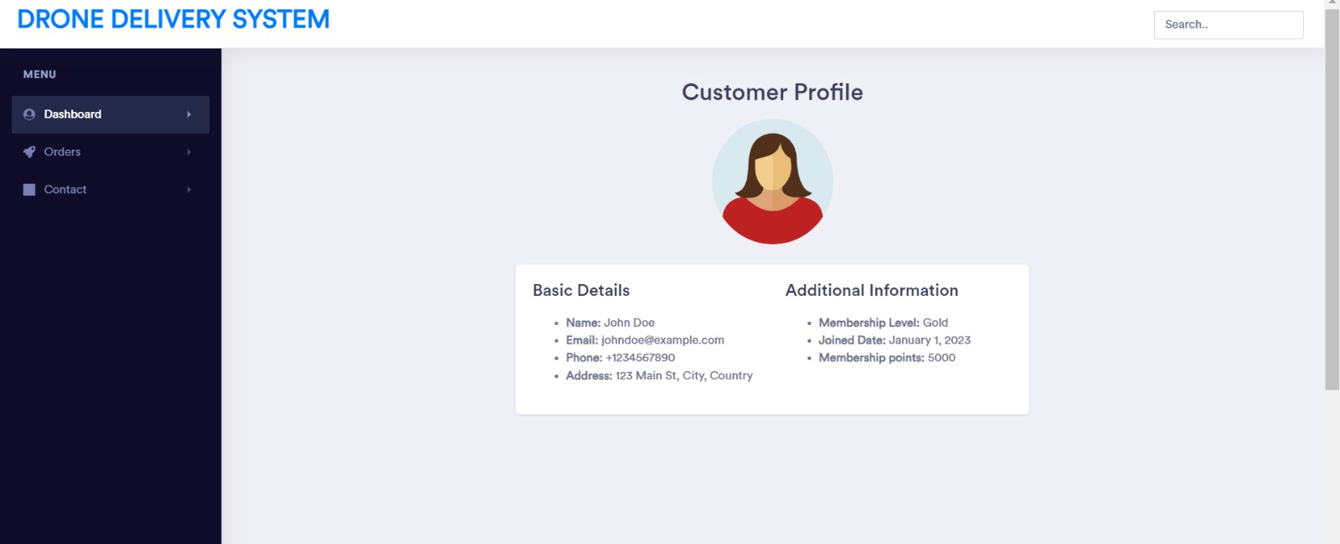
Customer Profile
Description
The dashboard includes a customer profile feature that displays the user's basic details along with additional information. This section shows the user's name, email, address, and mobile number. Additionally, it provides insights into the user's membership level, the date they joined the service, and their current membership points. This comprehensive profile helps users keep track of their membership status and benefits, enhancing their overall experience with Meals on Wings.

Slide 15
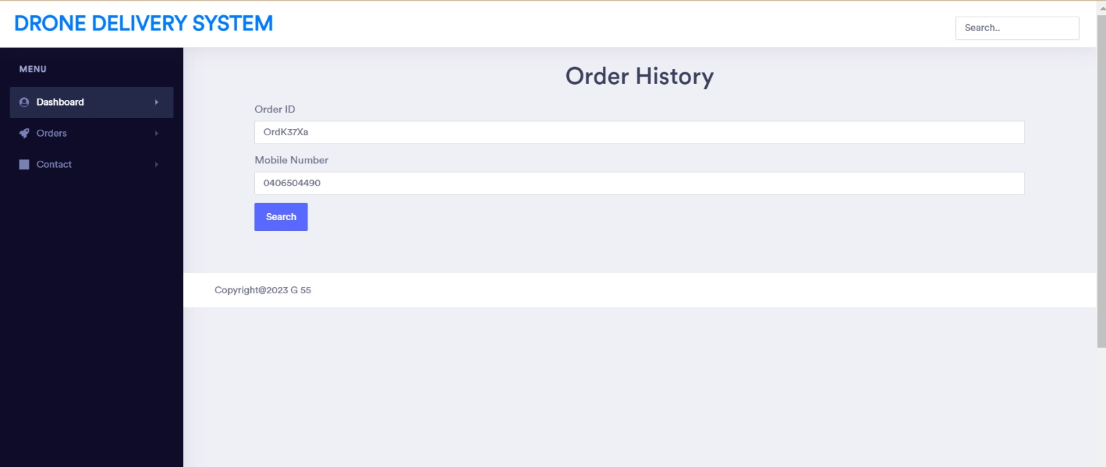
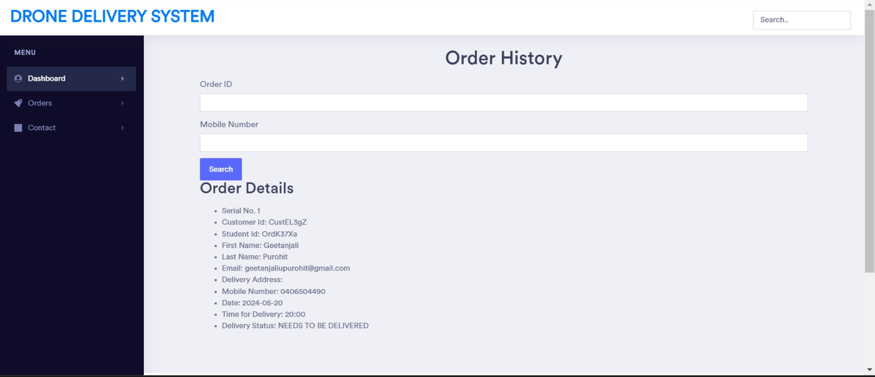
Order History in Customer Profile
Description
The customer profile feature on the dashboard also includes an order history section. This section provides basic details about the order, such as the order date, delivery time, and current delivery status. Users can view detailed information about a specific order by entering the order ID and their mobile number. This functionality allows users to track their order history and stay updated on the status of their deliveries, ensuring transparency and convenience.

Slide 16
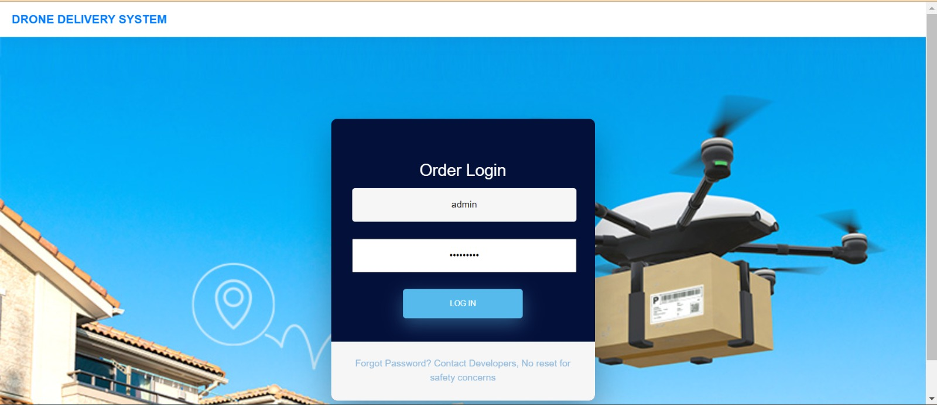
Admin Login
Admin Login
The system also includes an admin login page, which is specifically designed for administrative access. Administrators are required to enter their login credentials, including a username and password, to gain access. This secure login ensures that only authorized personnel can manage system settings, monitor all deliveries, and perform administrative tasks. This page helps maintain the integrity and security of the Meals on Wings system by restricting access to critical administrative functions.

Slide 17
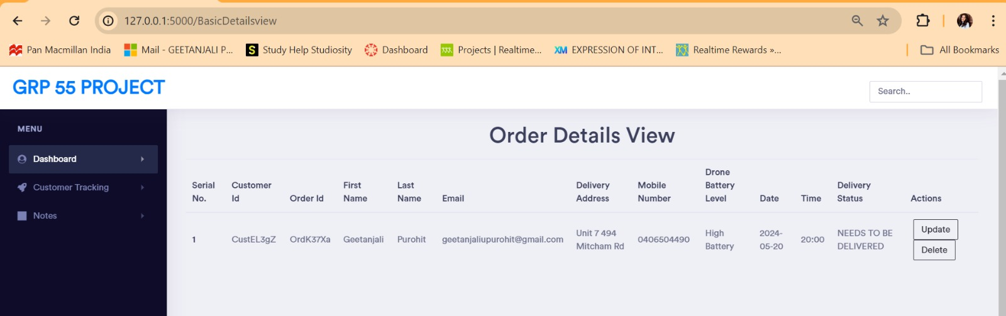
Admin Order Management Page
Description
The admin dashboard includes a detailed order management page. Here, administrators can view comprehensive details about each order, including the customer ID, order ID, and the customer's basic information. The page also shows the current delivery status of each order. Additionally, there is a tab that allows administrators to update or delete orders as needed. This functionality ensures that administrators have full control over order management, enabling them to make necessary adjustments and maintain efficient operations.

Slide 18
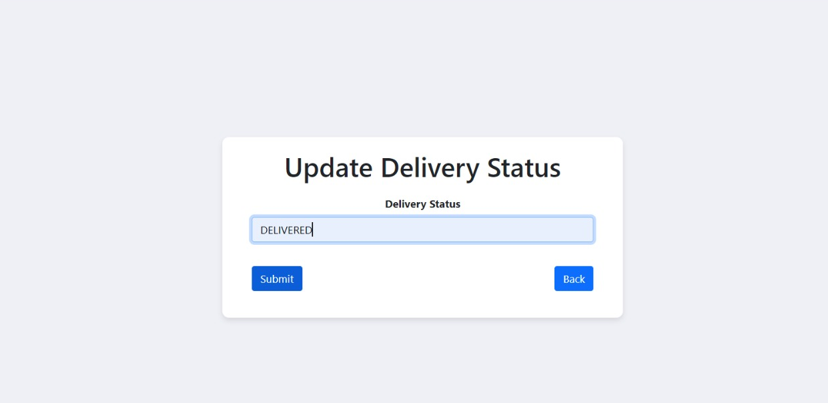
6. Instant Notification Feature
Description
Once delivered the admin can update the status of the order can alter to what their desire. This output will be fed through to the user’s side so they to will be aware of the status of their order.

Slide 19
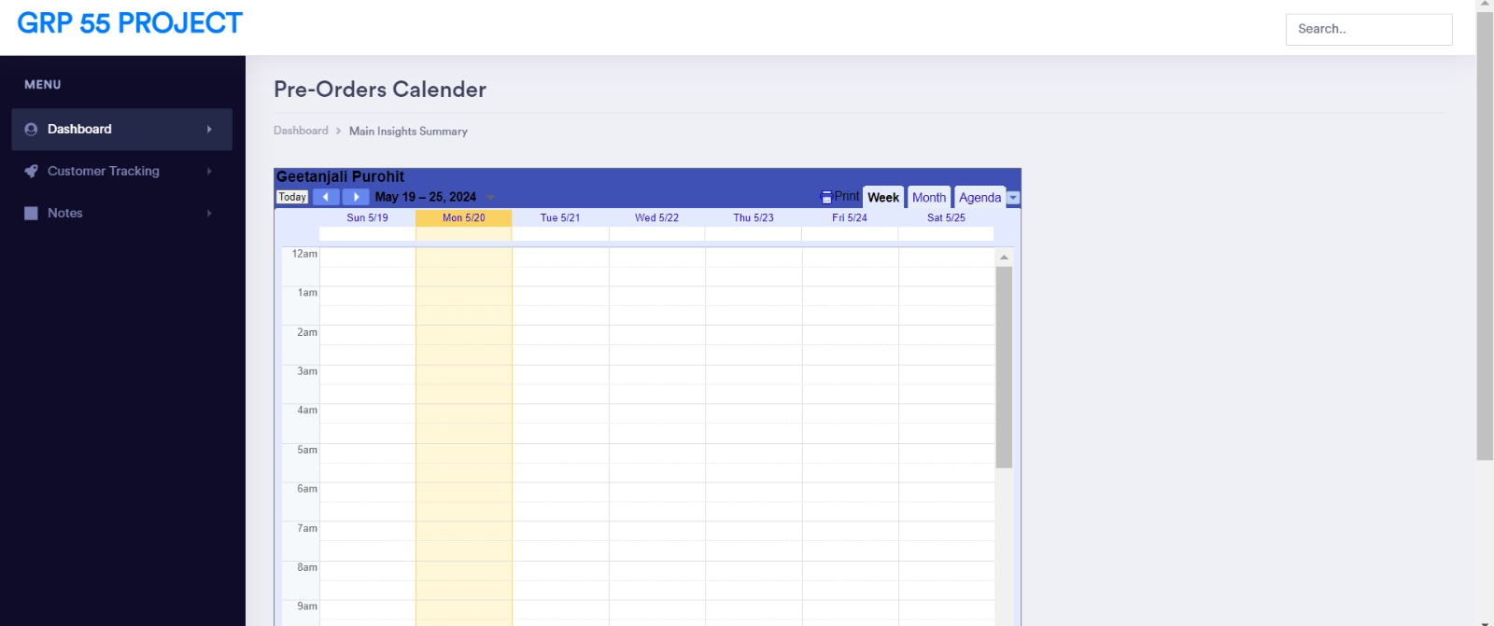
6. Instant Notification Feature
Description
Meals on Wings also utilises the google calendar api. Customers have the option to place orders ahead of time (i.e. 3 days in the furture). Once they have placed these pre-purchased options, the order itself will appear on the admin’s calendar that way they are informed of of these order ahead of schedule too.

Slide 20
04
Prototype Assumptions and Limitations

Slide 21
Prototype Assumptions and Limitations
Assumptions:
The project specification for the “Meals on Wings” drone food delivery simulation system makes absolutely no mention of weather condition. So, we have assumed weather is constant.
We have assumed a pre-defined menu for customers to order from instead off trying to populate the website with a lot of different items. Food can ordered from just one restaurant but it has different branches where the drone can operate from. For Example, Domino’s Pizza
We have also assumed that there is one admin who will be monitoring the interface to keep on an eye on the drone to track its battery level, distance travelled etc.
We have assumed that the drones can be recharged in the restaurants itself. So basically, we have used restaurants as recharging station for the drones.

Slide 22
Prototype Assumptions and Limitations
Limitations:
One of our limitations is similar to the presumption that customers may only be able to place an order from one restaurant. This limits people from ordering different types of food.
We can only send one drone for each restaurant. Because we were not able to send two drone from one restaurant.
The System function on the assumption of perfect and constant weather, ignoring the possible effects of bad weather on drone performance and delivery schedules. This restricts the possibility of us knowing if the system can work in all conditions.

Slide 23

Application
Live Demo

Slide 24
Thanks!
Do you have any questions?
102635116@student.swin.edu.au (Geetanjali)
103763801@student.swin.edu.au (Venuka)
104494801@student.swin.edu.au (Varun)

